Slide 1
ANOVA
Analysis Of Variance

Slide 2
Analysis of Variance
Introduction
Types of ANOVA

Slide 3
Introduction

Slide 4
Why ANOVA ?
Using various tests for Hypothesis, we have been comparing two populations.
Independent Samples t-test (random)
Matched sample t-test (paired)
However, this limit us to the comparison of two populations only.
If you wish to compare the means of more than two populations each containing several levels or subgroups we use ANOVA
ANalysis Of VAriance

Slide 5
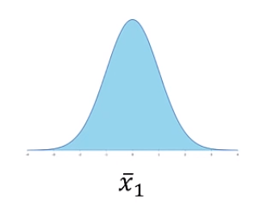
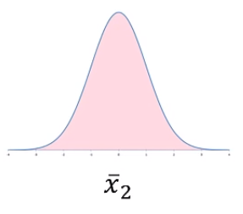
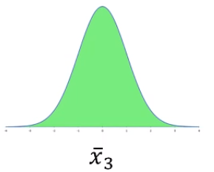
Concept of ANOVA
ANOVA is used when we wish to compare more than two populations/sample.
Suppose we want to compare THREE sample means to see if a difference exists among them or not.
Basically, What we are asking is:
Do all of these means comes from a common population ?
Or they come from different/unique populations ?

Slide 6
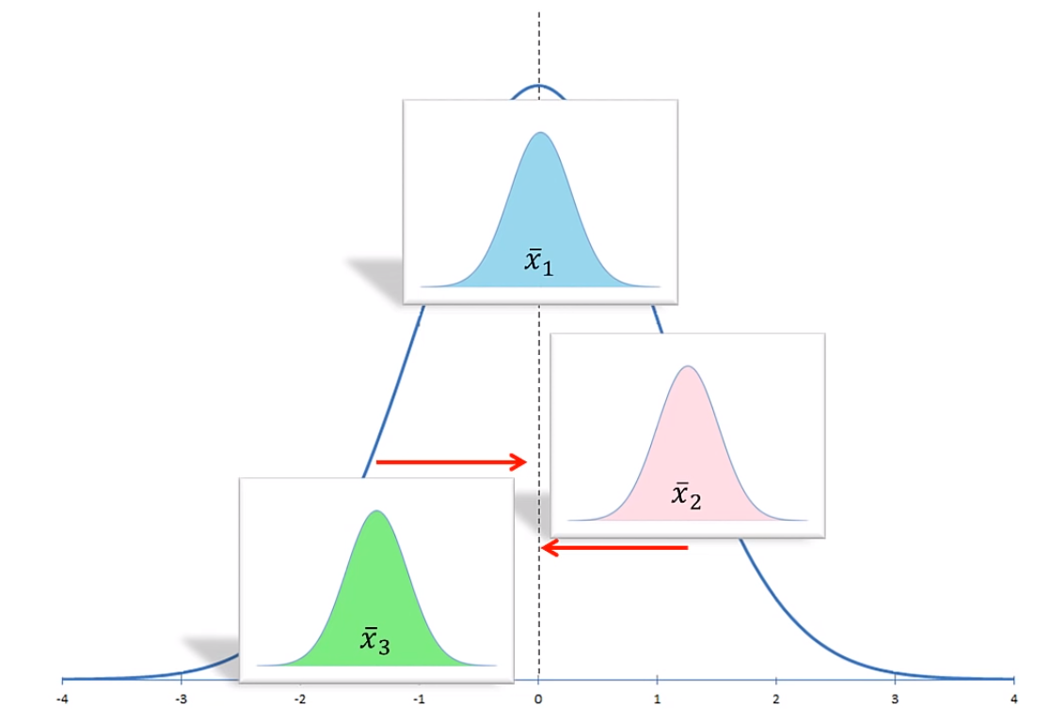
Concept of ANOVA
Mean of overall Combined Population
Mean of sample1
Mean of sample2
Mean of sample3

Slide 7
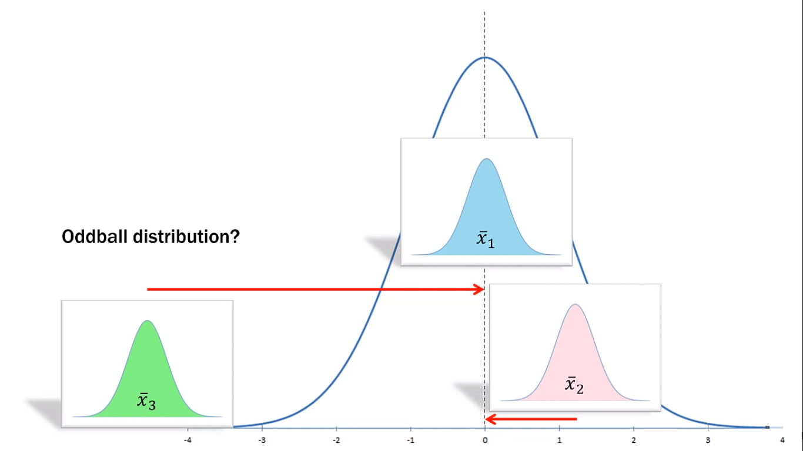
Concept of ANOVA
Sample3 does not belong to the population where other two samples come from

Slide 8
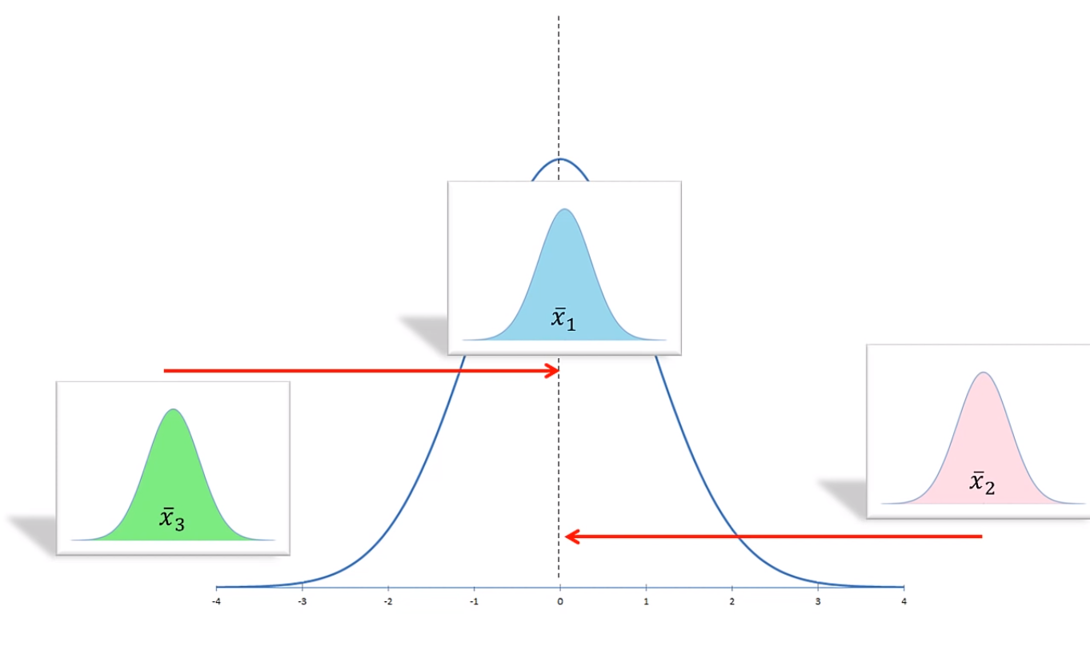
Concept of ANOVA
Each one of these sample means belong to their own population.

Slide 9
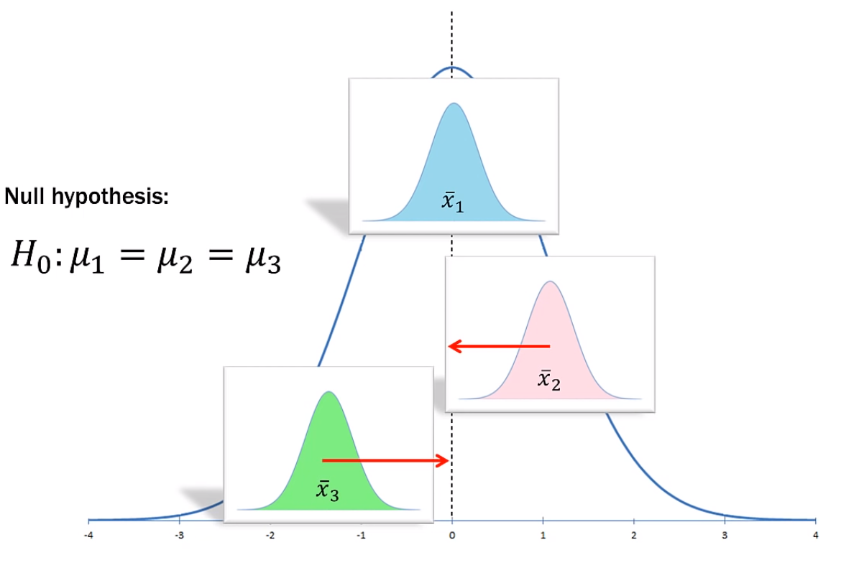
Concept of ANOVA
We are not asking if the means are exactly equal. We are asking if each mean likely come from the larger population

Slide 10
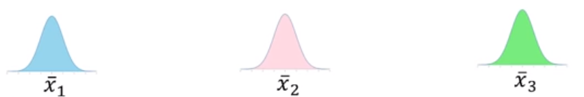
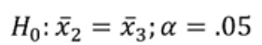
Concept of ANOVA
Why are we using ANOVA and why not multiple t-tests like we did in case of single sample and two sample ?
It is simple because the error rate compounds if we use t-test for all pairs. Let’s see how ?
We have three samples:
The Pairs for t-test will be:
Pairwise Comparison means : Three t-tests ALL with α = 0.05
Alpha is Type I error rate (at 95% Confidence Interval)
The error compounds with each test: (0.95)*(0.95)*(0.95) = 0.857
α = 1 – 0.857 = 0.143

Slide 11
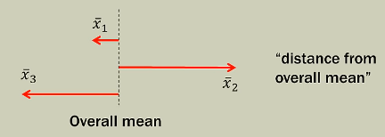
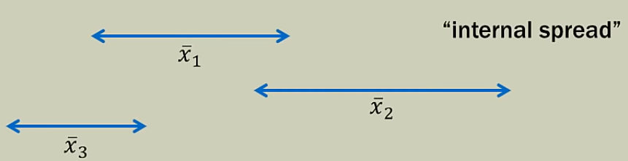
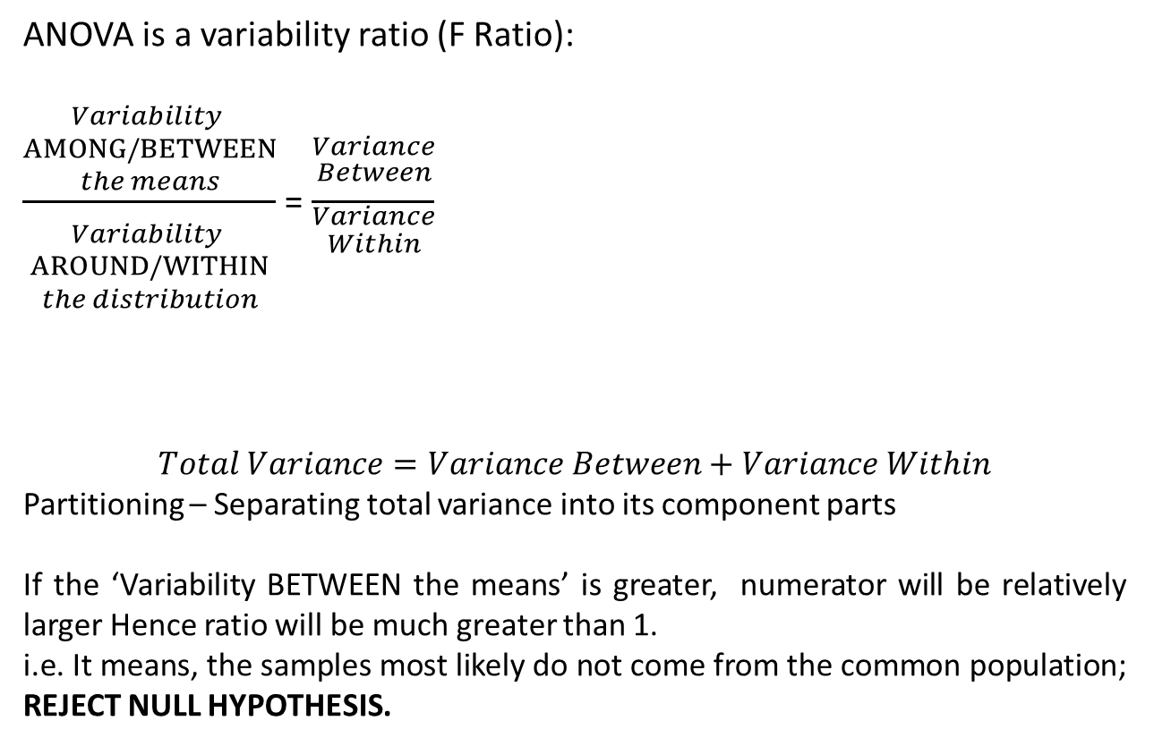
Concept of ANOVA
ANOVA is a variability ratio (F Ratio):
$\frac{\begin{aligned}Variability \\ AMONG/BETWEEN \\ the means \\ \end{aligned}}{\begin{aligned} \\ \\ Variability \\ AROUND/WITHIN \\ the distribution\end{aligned}}$ = $\frac{\begin{aligned}Variance \\ Between \\ \\ \end{aligned}}{\begin{aligned}Variance \\ Within\end{aligned}}$
$$Total Variance=Variance Between+Variance Within$$
Partitioning – Separating total variance into its component parts
If the ‘Variability BETWEEN the means’ is greater, numerator will be relatively larger Hence ratio will be much greater than 1.
i.e. It means, the samples most likely do not come from the common population; REJECT NULL HYPOTHESIS.

Slide 12
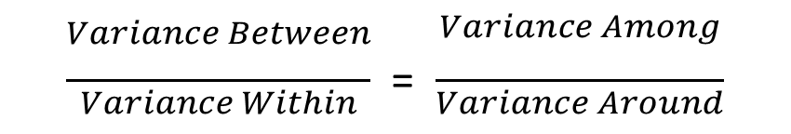
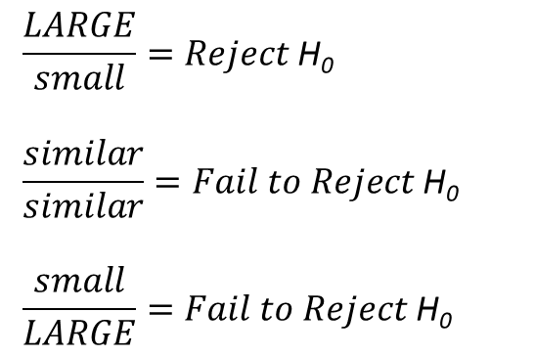
Concept of ANOVA
$\frac{\begin{aligned}Variance Between \\ \\ \\ \end{aligned}}{\begin{aligned}Variance Within \\ \end{aligned}}$ = $\frac{\begin{aligned}Variance Among \\ \\ \\ \end{aligned}}{\begin{aligned}Variance Around \\ \end{aligned}}$
$$\frac{LARGE}{small}=Reject \text{H}\text{0}$$
$$\frac{similar}{similar}=Fail to Reject \text{H}\text{0}$$
$$\frac{small}{LARGE}=Fail to Reject \text{H}\text{0}$$
At least one mean is an outlier
Means are fairly close to overall mean and distributions overlap a bit
Means are very close to overall mean and the distributions melt together.

Slide 13
Types of ANOVA

Slide 14
Types of ANOVA
Types of ANOVA
One Way ANOVA (One Factor ANOVA)
Two way ANOVA without Replication (Two Factor ANOVA)
Two way ANOVA with Replication (Two Factor ANOVA)

Slide 15
Why ANOVA ?
Using various tests for Hypothesis, we have been comparing two populations.
Independent Samples t-test (random)
Matched sample t-test (paired)
However, this limit us to the comparison of two populations only.
If you wish to compare the means of more than two populations each containing several levels or subgroups we use ANOVA
ANalysis Of VAriance

Slide 16
Example – One way ANOVA
Twenty One students at University of Madrid in Spain were selected for a test on few common topics combined.
7 first year students, 7 second year students, 7 third year students were randomly selected.
Students undertook assessment having maximum score of 100.
We are interested in whether or not a difference exists somewhere between the three different year levels ?

Slide 17
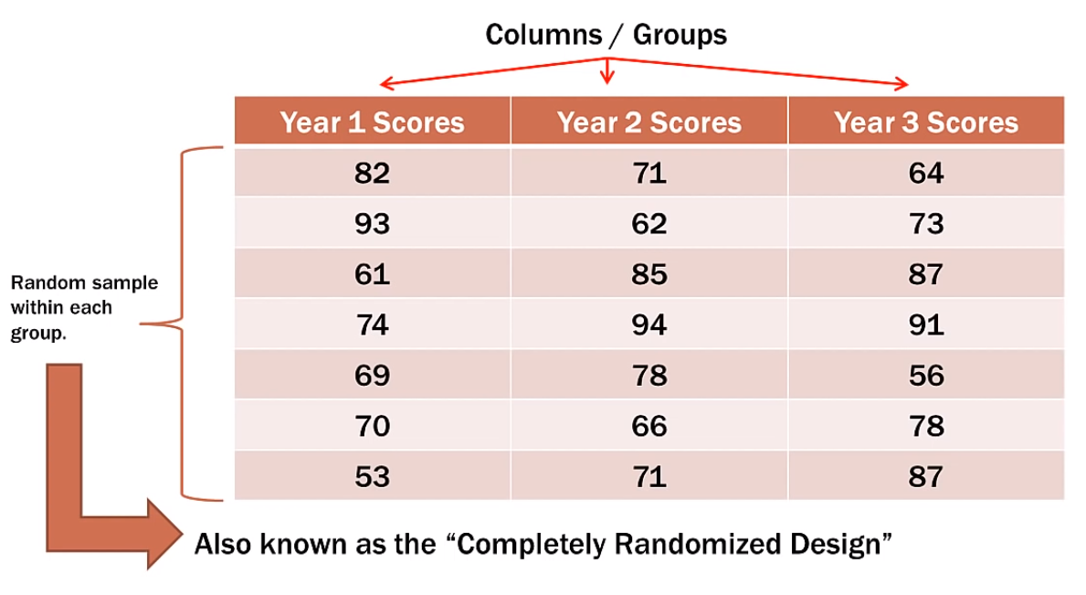
Example – One way ANOVA
Single Factor
‘year of student’

Slide 18
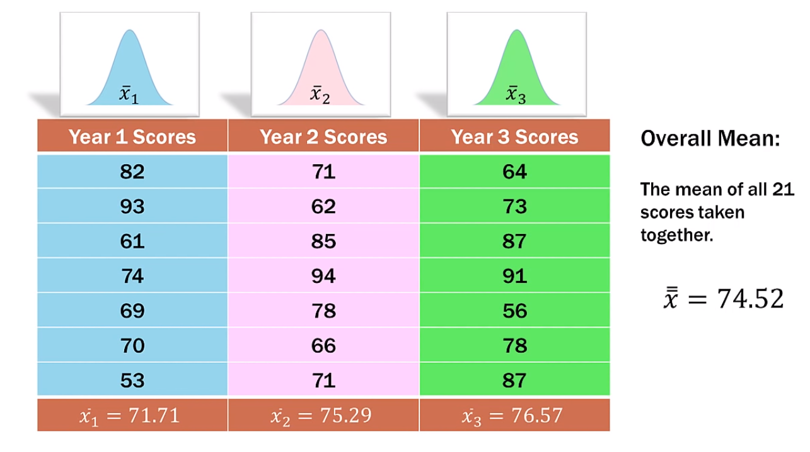
Example – One way ANOVA
Step 1: Calculate Mean of each column
Step 2: Calculate Overall Mean

Slide 19
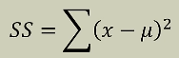
Example – One way ANOVA
Step 3: Calculate Sum of Squares (SST, SSC, SSE)
SST = SSC + SSE
Where
SST = Sum of square Totals or Total Sum of Squares, which is
Sum of square of (Each item in all samples – Overall Mean)
SSC = Sum of Square of Columns, which is
Sum of square of (Each Group Mean – Overall Mean)
SSE = Sum of Square or Sum of Square of Errors, which is
Sum of square if (Each item in a group – Mean of that group)

Slide 20
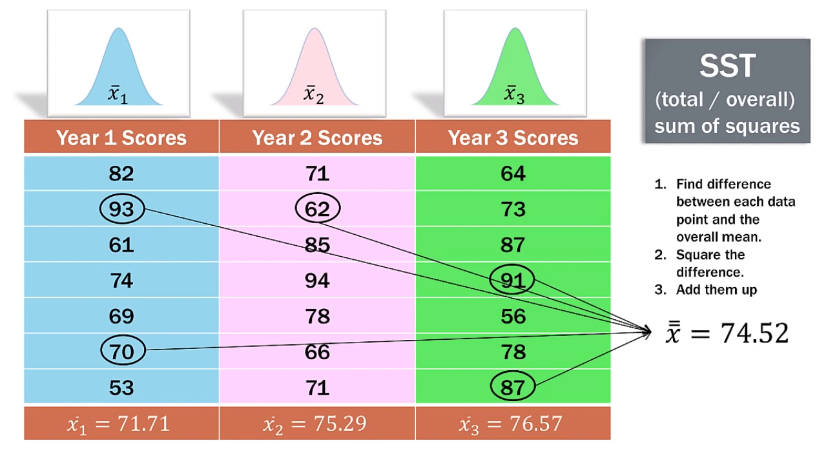
Example – One way ANOVA
Step 3: Calculate Sum of Squares (SST, SSC, SSE)
SST = 2901.238

Slide 21
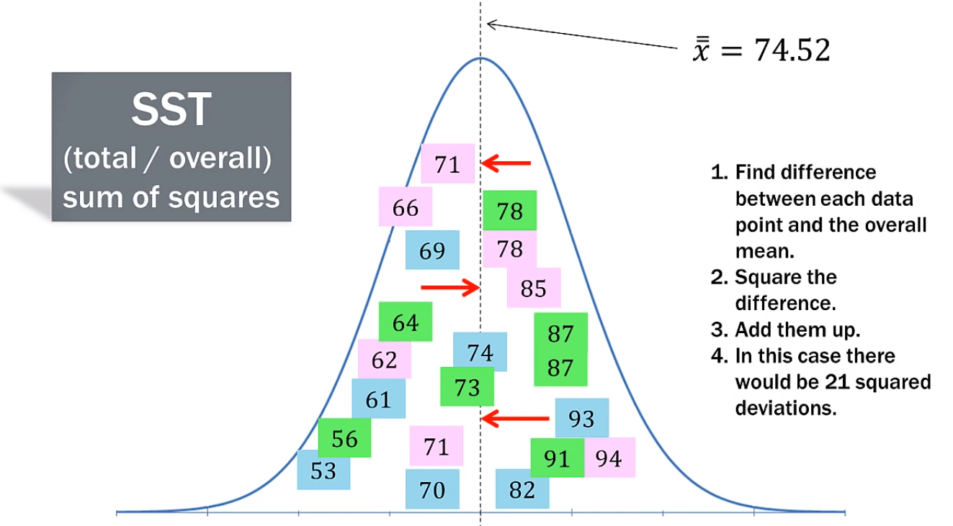
Example – One way ANOVA
Step 3: Calculate Sum of Squares (SST, SSC, SSE)

Slide 22
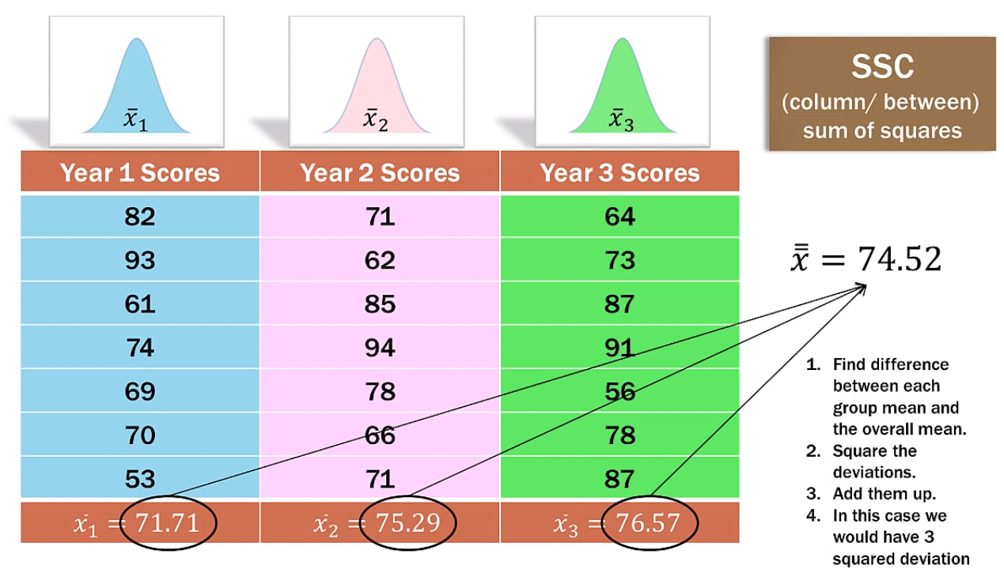
Example – One way ANOVA
Step 3: Calculate Sum of Squares (SST, SSC, SSE)
SSC = 88.66

Slide 23
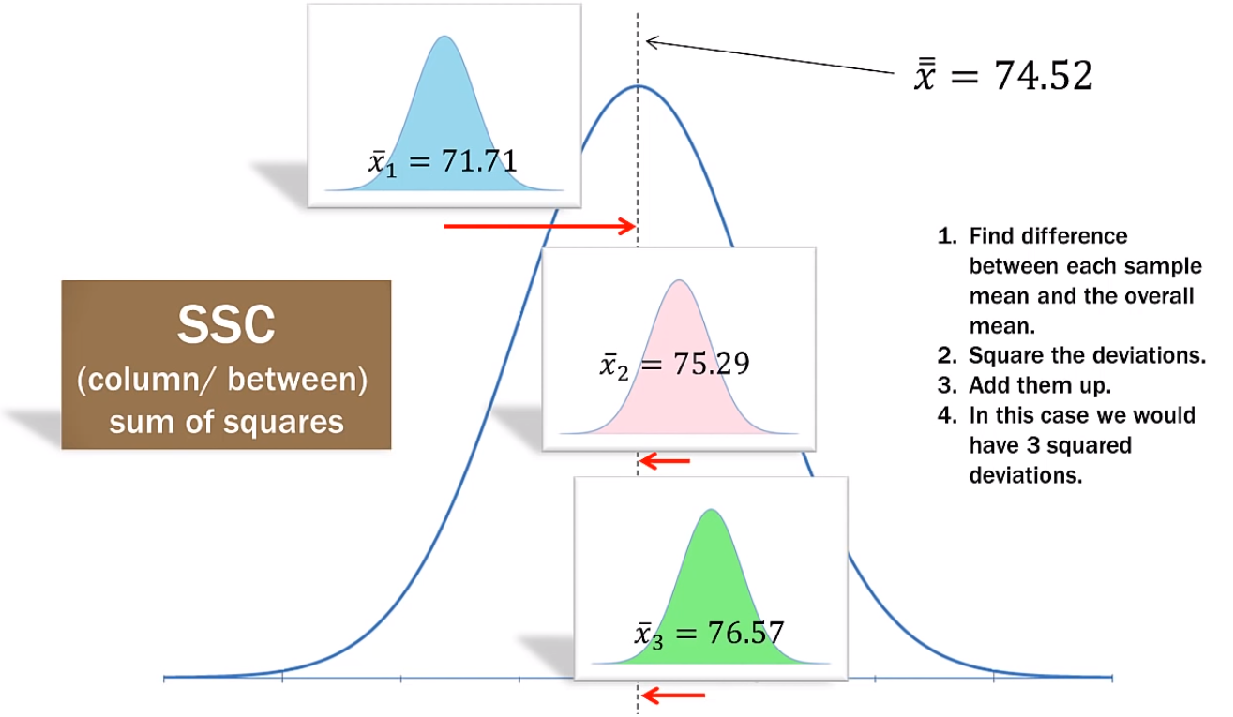
Example – One way ANOVA
Step 3: Calculate Sum of Squares (SST, SSC, SSE)

Slide 24
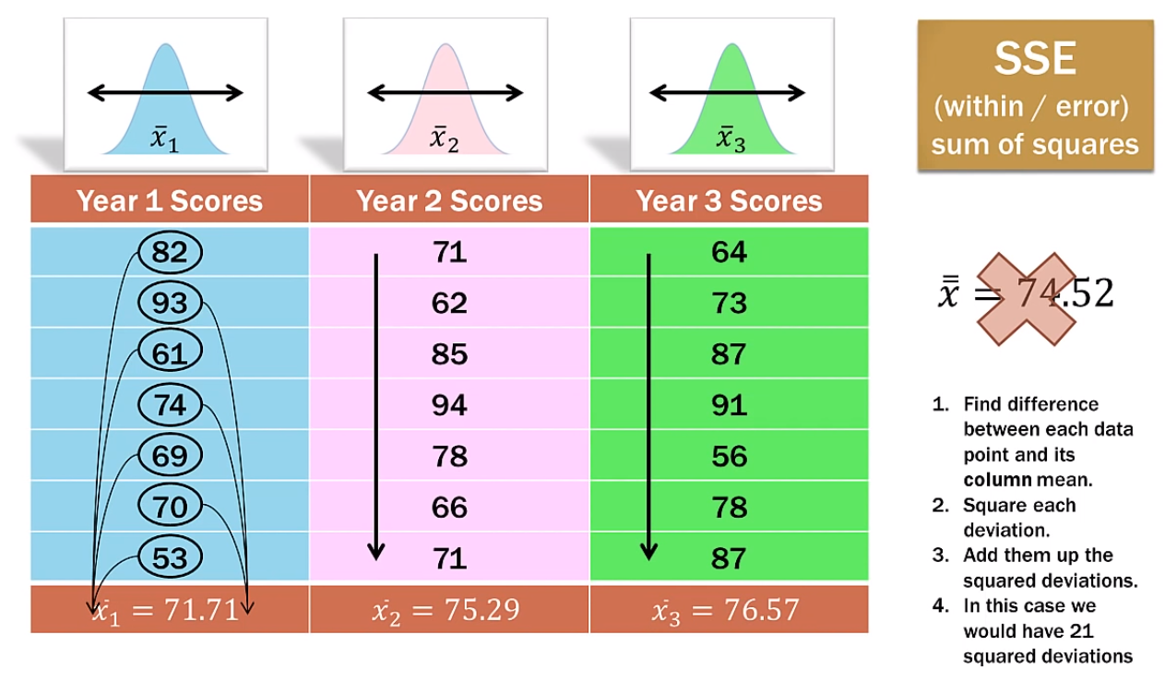
Example – One way ANOVA
Step 3: Calculate Sum of Squares (SST, SSC, SSE)
SSE = 2812.571

Slide 25
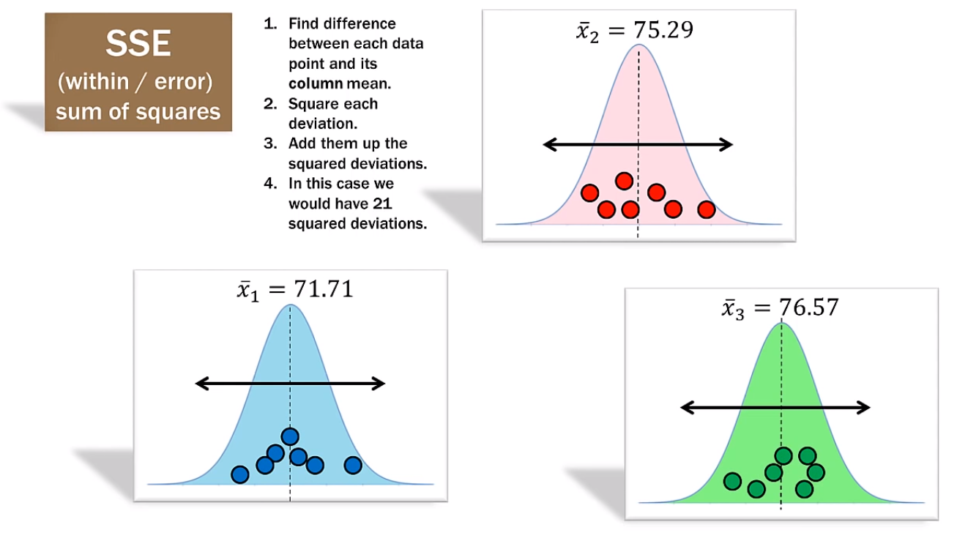
Example – One way ANOVA
Step 3: Calculate Sum of Squares (SST, SSC, SSE)

Slide 26
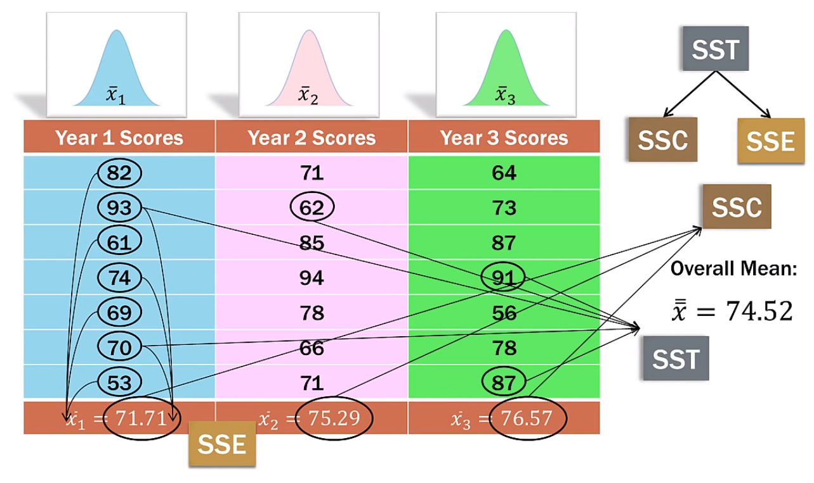
Example – One way ANOVA
Step 3: Calculate Sum of Squares (SST, SSC, SSE)

Slide 27
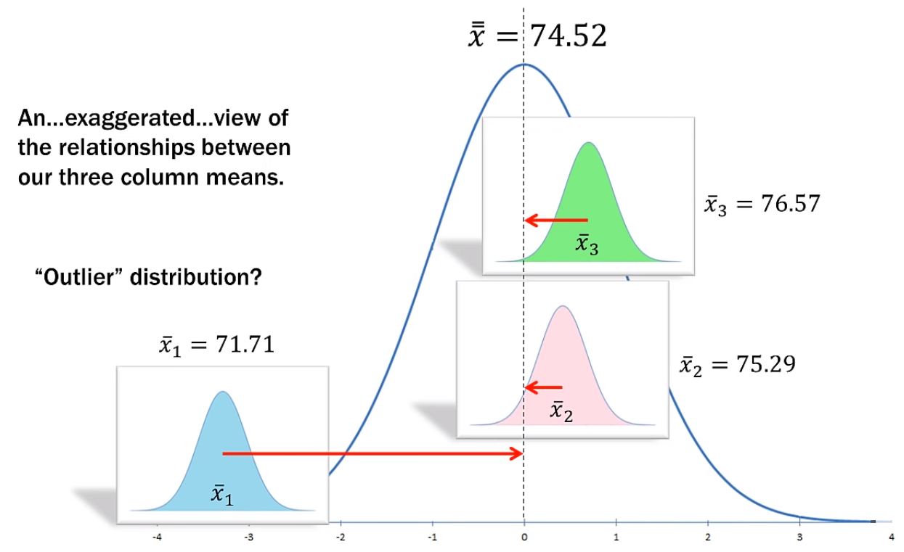
Example – One way ANOVA
Step 3: Calculate Sum of Squares (SST, SSC, SSE)

Slide 28
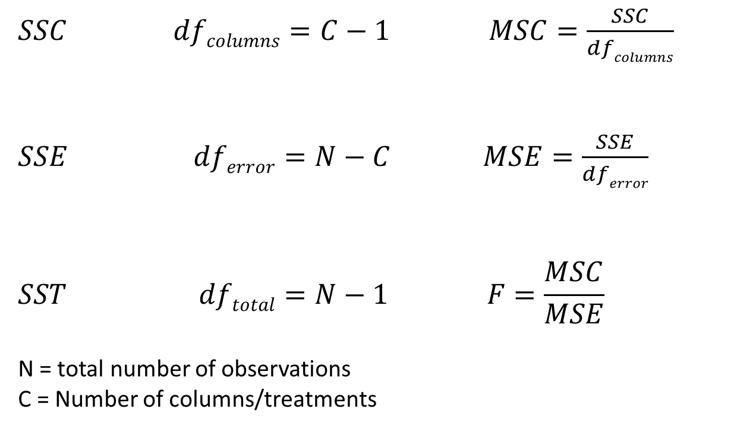
Example – One way ANOVA
Step 4: Calculate Degree of Freedom (df), MSC and MSE
$SSC dfcolumns=C−1 MSC=\frac{SSC}{dfcolumns}$
$SSE dferror=N−C MSE=\frac{SSE}{dferror}$
$$SST dftotal=N−1 F=\frac{MSC}{MSE}$$
N = total number of observations
C = Number of columns/treatments

Slide 29
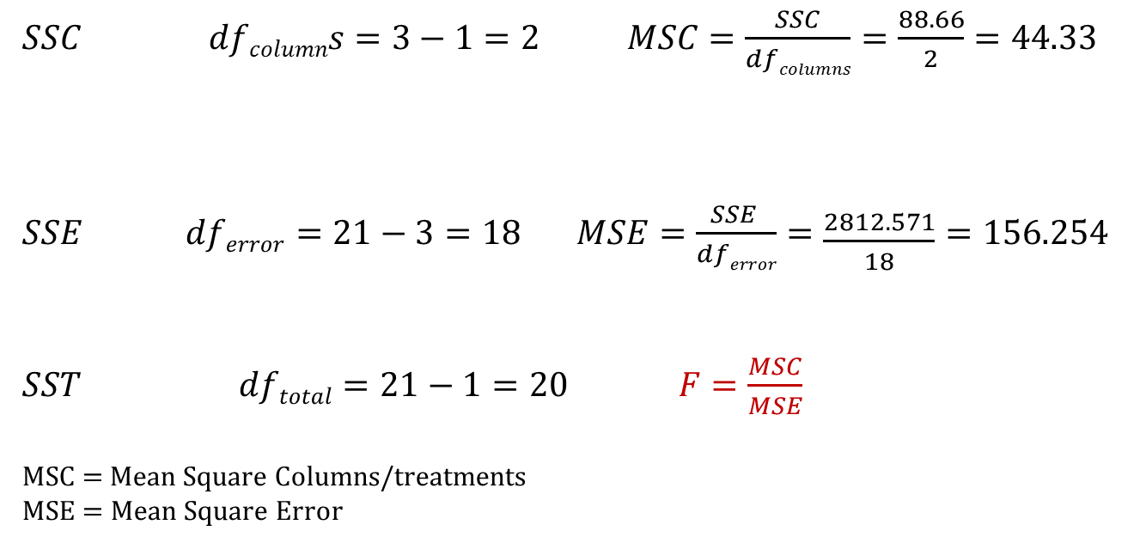
Example – One way ANOVA
Step 4: Calculate Degree of Freedom (df), MSC and MSE
$SSC dfcolumns=3−1=2 MSC=\frac{SSC}{dfcolumns}=\frac{88.66}{2}=44.33$
$SSE dferror=21−3=18 MSE=\frac{SSE }{dferror}=\frac{2812.571}{18}=156.254$
$SST dftotal=21−1=20 F=\frac{MSC}{MSE}$
MSC = Mean Square Columns/treatments
MSE = Mean Square Error

Slide 30
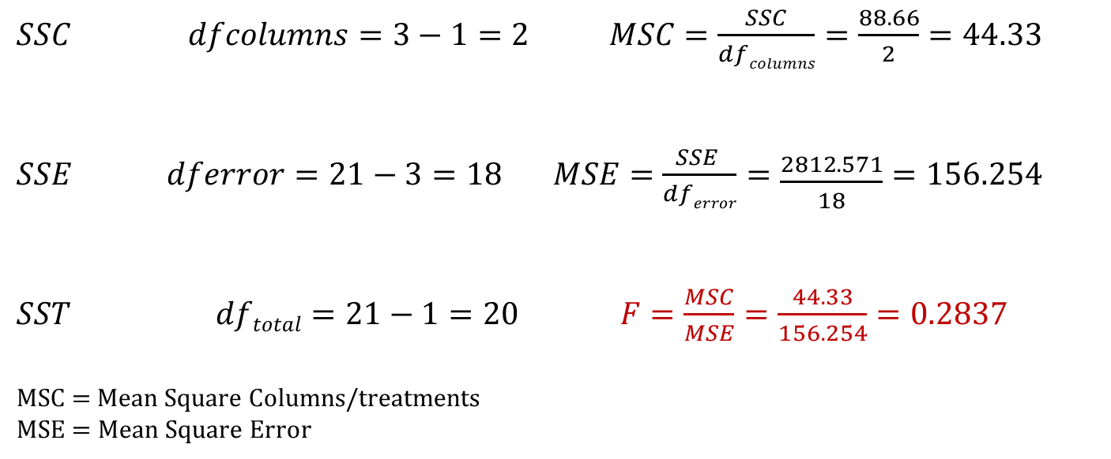
Example – One way ANOVA
Step 5: Calculate F Ratio
$SSC dfcolumns=3−1=2 MSC=\frac{SSC}{dfcolumns}=\frac{88.66}{2}=44.33$
$SSE dferror=21−3=18 MSE=\frac{SSE }{dferror}=\frac{2812.571}{18}=156.254$
$SST dftotal=21−1=20 F=\frac{MSC}{MSE}=\frac{44.33}{156.254}=0.2837$
MSC = Mean Square Columns/treatments
MSE = Mean Square Error

Slide 31
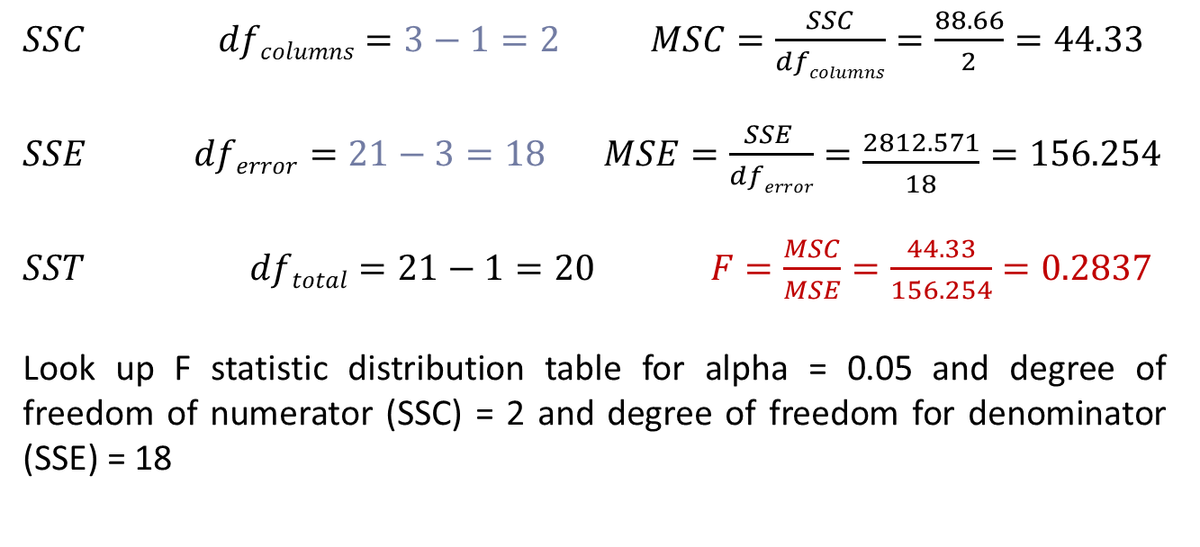
Example – One way ANOVA
Step 6: Calculate F Critical Value
$SSC dfcolumns=3−1=2 MSC=\frac{SSC}{dfcolumns}=\frac{88.66}{2}=44.33$
$SSE dferror=21−3=18 MSE=\frac{SSE }{dferror}=\frac{2812.571}{18}=156.254$
$SST dftotal=21−1=20 F=\frac{MSC}{MSE}=\frac{44.33}{156.254}=0.2837$
Look up F statistic distribution table for alpha = 0.05 and degree of freedom of numerator (SSC) = 2 and degree of freedom for denominator (SSE) = 18

Slide 32
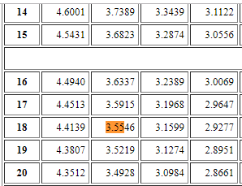
Example – One way ANOVA
Step 6: Calculate F Critical Value
Look up F statistic distribution table for alpha = 0.05 and degree of freedom of numerator (SSC) = 2 and degree of freedom for denominator (SSE) = 18. Refer F statistics table.

Slide 33
Example – One way ANOVA
Step 7: Inference
F Ratio = 0.2837
While the F critical value for alpha = 0.05 is
F critical = 3.5546
Is our F statistic (i.e. F Ratio) value larger or beyond F critical ?
No. Hence our NULL Hypothesis holds.
i.e. We fail to reject the H₀
Hence, there is no significant difference in mean test score by Year of Student.

Slide 34
Why ANOVA ?
Using various tests for Hypothesis, we have been comparing two populations.
Independent Samples t-test (random)
Matched sample t-test (paired)
However, this limit us to the comparison of two populations only.
If you wish to compare the means of more than two populations each containing several levels or subgroups we use ANOVA
ANalysis Of VAriance

Slide 35
Two-Way ANOVA ‘BLOCK’ Design
In one-way ANOVA we selected random sample for each column/treatment group
Two-way ANOVA allows us to ‘account for variation’ at the ROW level due to some other factor or grouping.
i.e. in two-way ANOVA we add another dimension, the row dimension based on certain criteria.
Here in two-way ANOVA, we attempt to minimize the ERROR variance by saying that some of the ERROR variance is actually due to the variance in the ROWS.
So here, we now have 4 types of Sum of Squares (Sources of variance):
Total Variance = SSC + SSE + SSB (Sum of Square of Rows/Blocks)

Slide 36
Example – Two way ANOVA – Without Rep
Starbucks under the pressure of Quality Control, sends out 6 Shopper inspectors as regular customers to the Australian cities of Sydney, Brisbane and Melbourne.
These 6 inspectors will visit the same stores in each 3 cities in a random manner. They will do the survey and check how well the store is managed, how good is the service and quality of products etc.
Here, Starbucks Management like to know If a difference in the Inspector ratings exists among the cities. Are they all same ? Is one significantly higher than the other two ?
Are all three different from each other ?
Note: What makes this problem good fit for Two-way ANOVA is that the Inspectors will have their own natural variation.

Slide 37
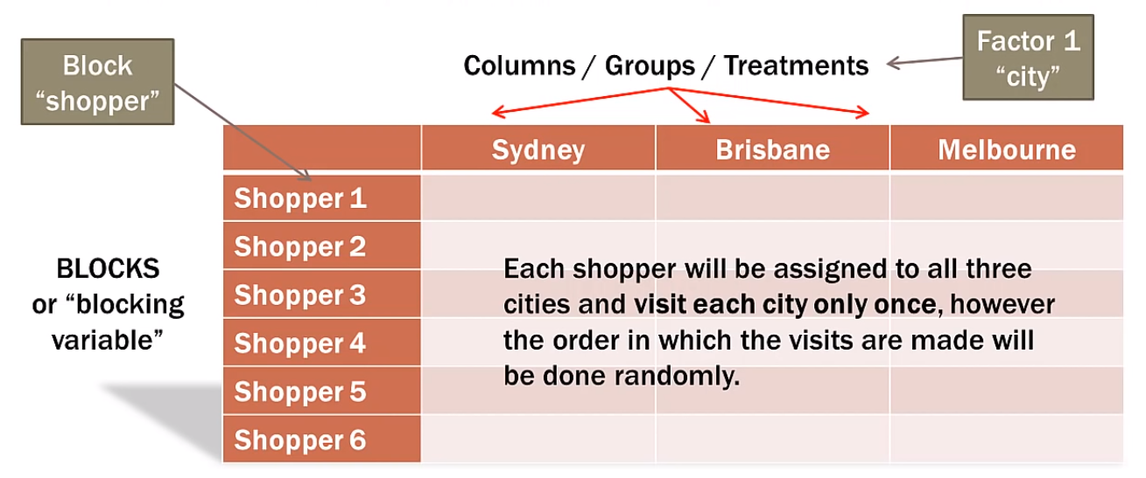
Example – Two way ANOVA – Without Rep

Slide 38
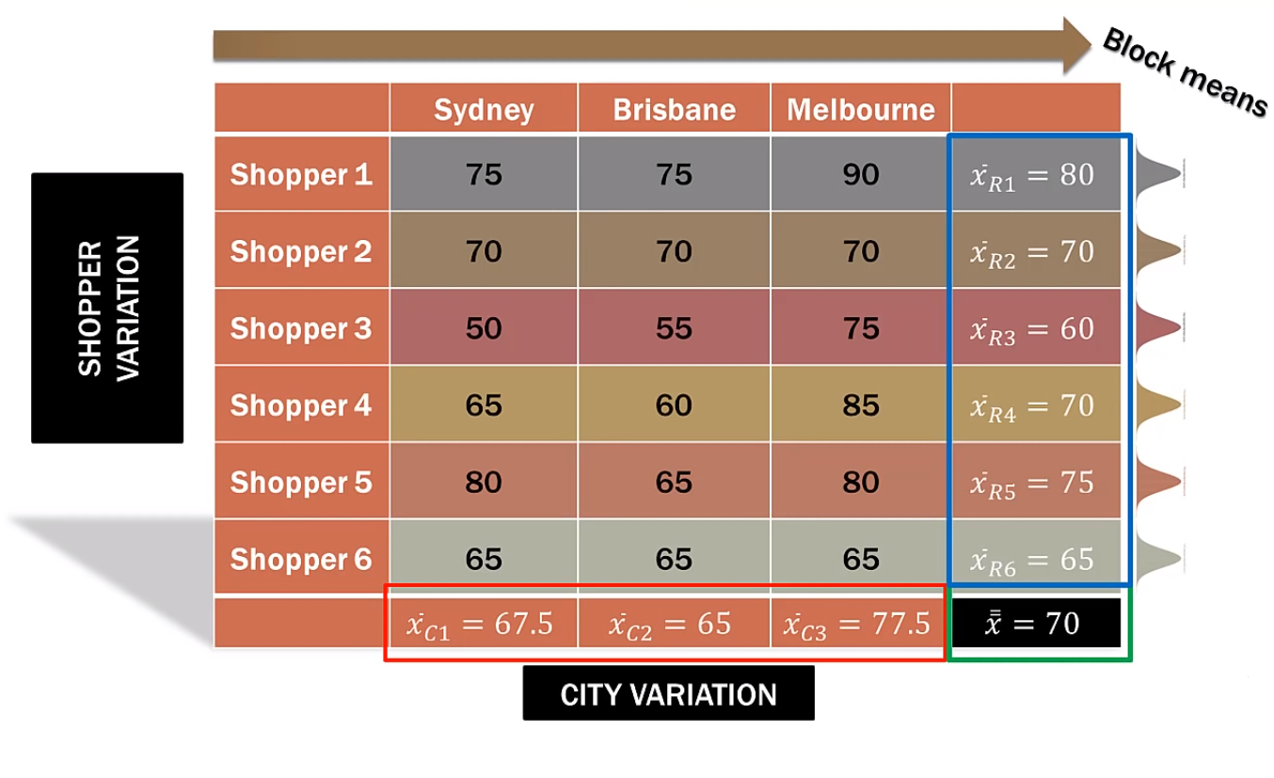
Example – Two way ANOVA – Without Rep
Step 1: Find Column means, Row Means
Step 2: Find the Overall Mean

Slide 39
Example – Two way ANOVA – Without Rep
Step 3: Calculate Sum of Squares (SST, SSC, SSE, SSB)
SST = SSC + SSE + SSB
Where
SST = Sum of square Totals or Total Sum of Squares, which is
Sum of square of (Each item in all samples – Overall Mean)
SSC = Sum of Square of Columns, which is
Sum of square of (Each Group Mean – Overall Mean)
SSE = Sum of Square or Sum of Square of Errors, which is
Sum of square if (Each item in a group – Mean of that group)
SSB = Sum of Square Errors of Blocks, which is
Sum of square of (Each average in block – Overall Mean)

Slide 40
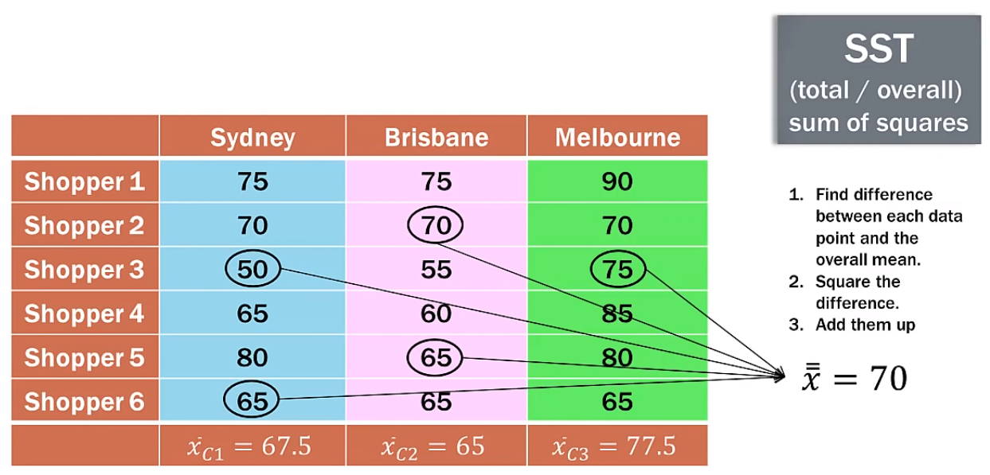
Example – Two way ANOVA – Without Rep
Step 3: Calculate Sum of Squares (SST, SSC, SSE, SSB)
SST = 1750

Slide 41
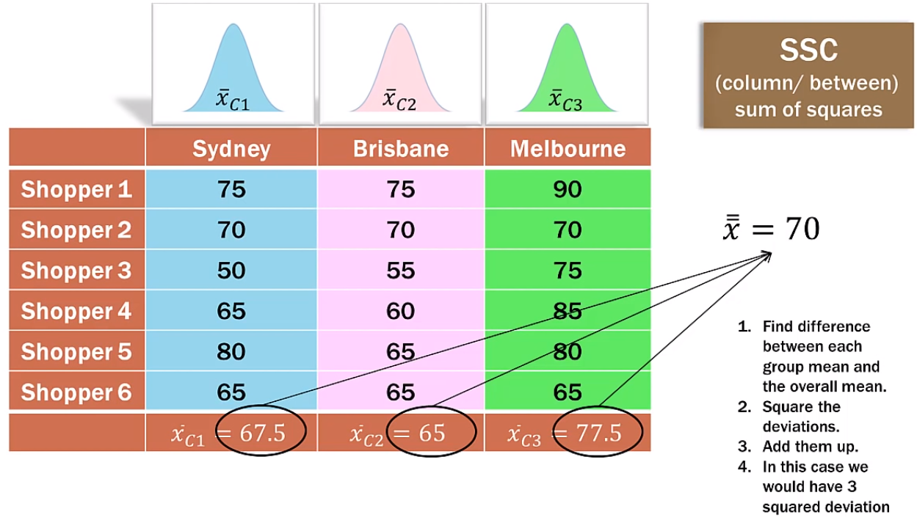
Example – Two way ANOVA – Without Rep
Step 3: Calculate Sum of Squares (SST, SSC, SSE, SSB)
SSC = SSC * No of blocks
SSC = 87.5 * 6 = 525

Slide 42
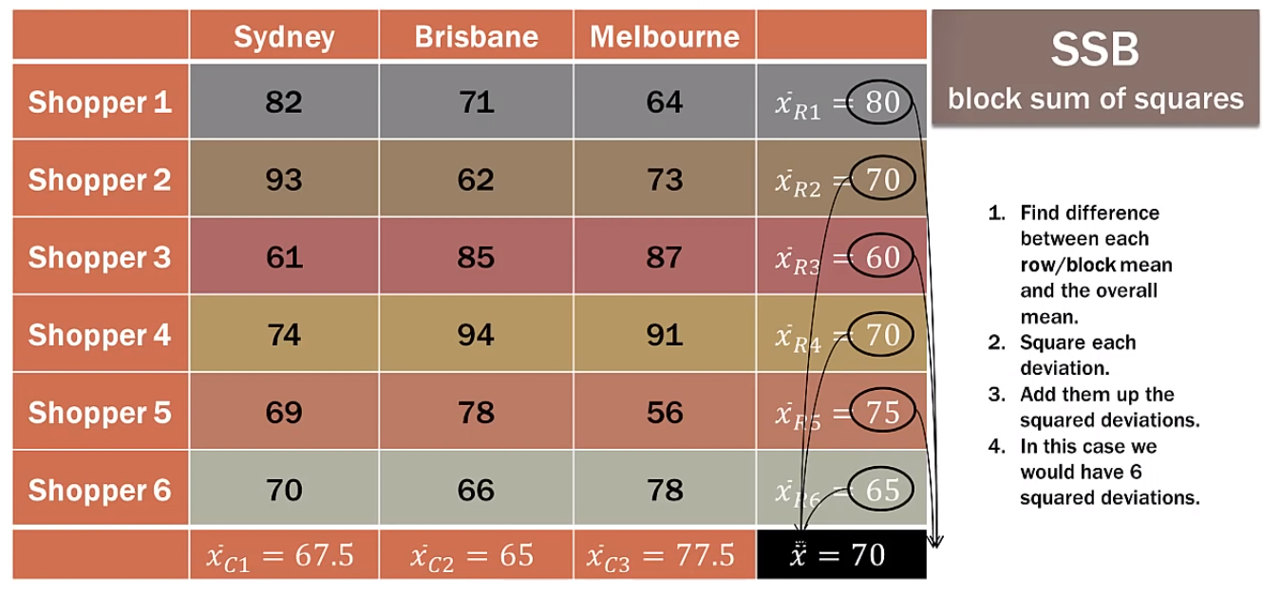
Example – Two way ANOVA – Without Rep
Step 3: Calculate Sum of Squares (SST, SSC, SSE, SSB)
SSB = SSB * No of Columns/Groups = 250 * 3 = 750

Slide 43
Example – Two way ANOVA – Without Rep
Step 3: Calculate Sum of Squares (SST, SSC, SSE, SSB)
Step 3: Calculate Sum of Squares (SST, SSC, SSE, SSB)
SST = SSC + SSE + SSB
Hence
SSE = SST – SSC – SSB
SSE = 1750 – 525 – 750 = 475
SSE = 475

Slide 44
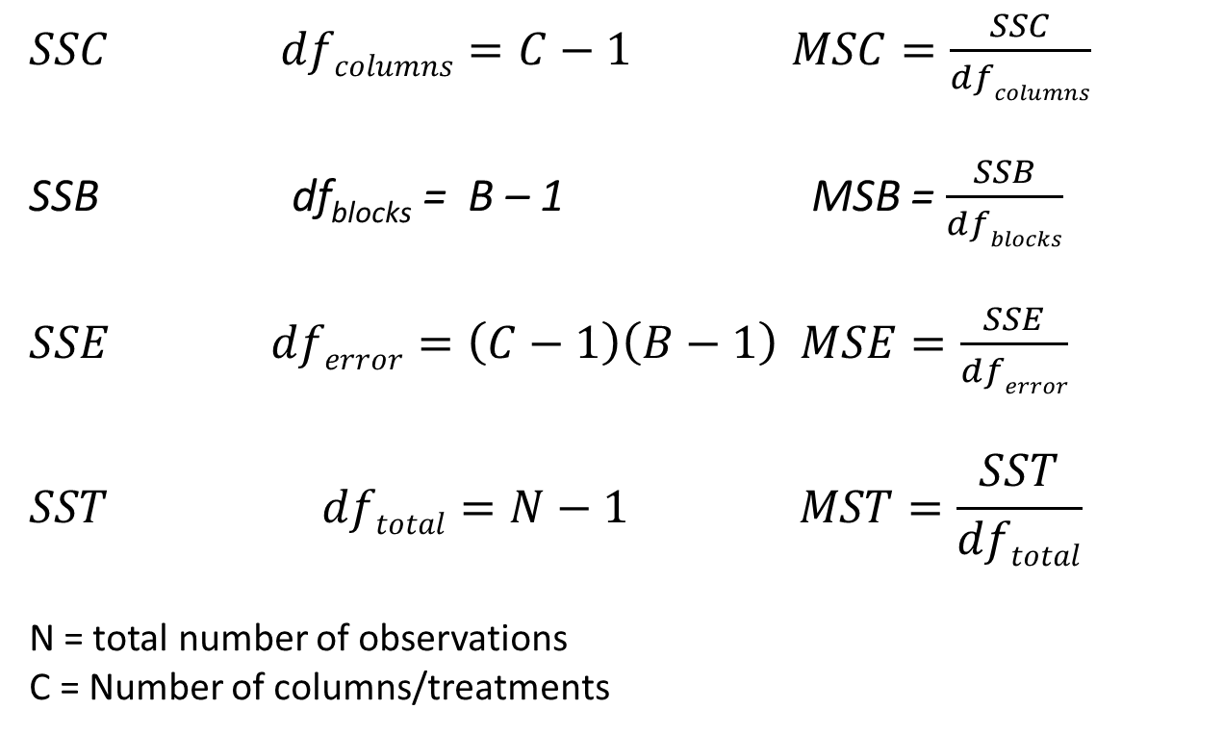
Example – Two way ANOVA – Without Rep
Step 4: Calculate Degree of Freedom (df), MSC, MSB and MSE
$SSC dfcolumns=C−1 MSC=\frac{SSC}{dfcolumns}$
SSB df_{blocks} = B – 1 MSB = $\frac{SSB}{dfblocks}$
$SSE dferror=\left(C−1\right)\left(B−1\right) MSE=\frac{SSE}{dferror}$
$$SST dftotal=N−1 MST=\frac{SST}{dftotal}$$
N = total number of observations
C = Number of columns/treatments

Slide 45
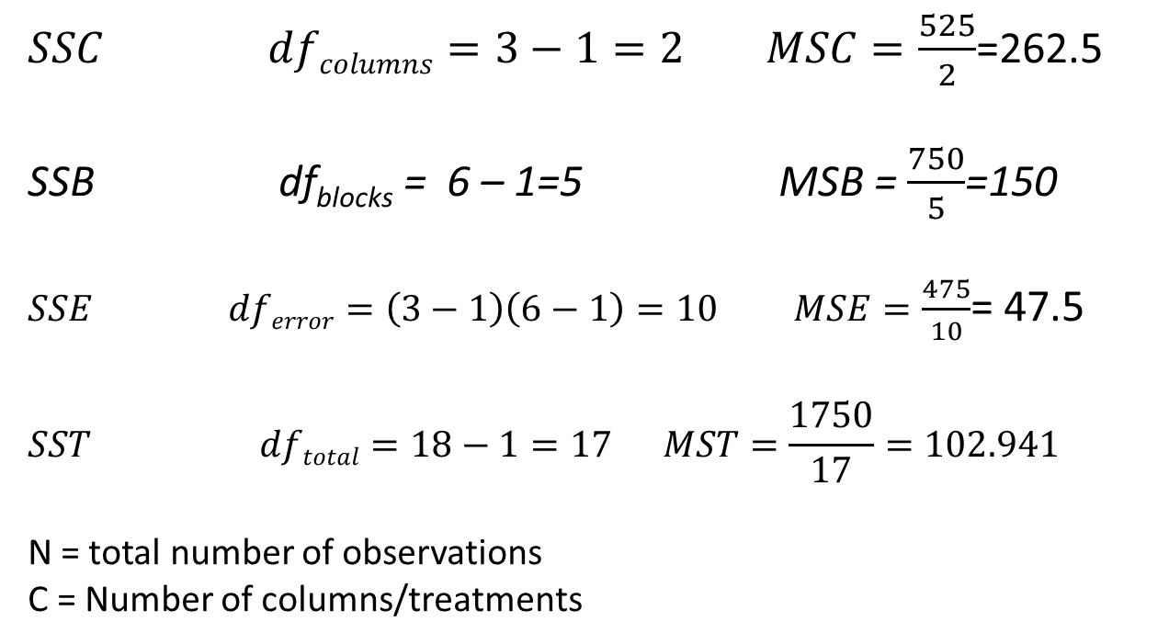
Example – Two way ANOVA – Without Rep
Step 4: Calculate Degree of Freedom (df), MSC, MSB and MSE
$SSC dfcolumns=3−1=2 MSC=\frac{525}{2}$=262.5
SSB df_{blocks} = 6 – 1=5 MSB = $\frac{750}{5}$=150
$SSE dferror=\left(3−1\right)\left(6−1\right)=10 MSE=\frac{475}{10}$= 47.5
$$SST dftotal=18−1=17 MST=\frac{1750}{17}=102.941$$
N = total number of observations
C = Number of columns/treatments

Slide 46
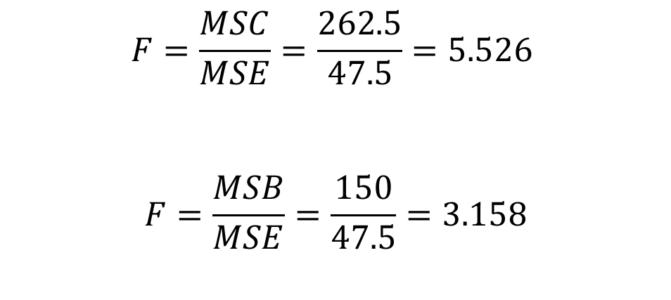
Example – Two way ANOVA – Without Rep
Step 5: Calculate F Ratios
We are interested in differences in the city ratings, hence the first ratio is important for us.
However, you can check for the variations in ratings of shoppers as well, for that we can make use of second F-ratio given below.
$$F=\frac{MSC}{MSE}=\frac{262.5}{47.5}=5.526$$
$$F=\frac{MSB}{MSE}=\frac{150}{47.5}=3.158$$

Slide 47
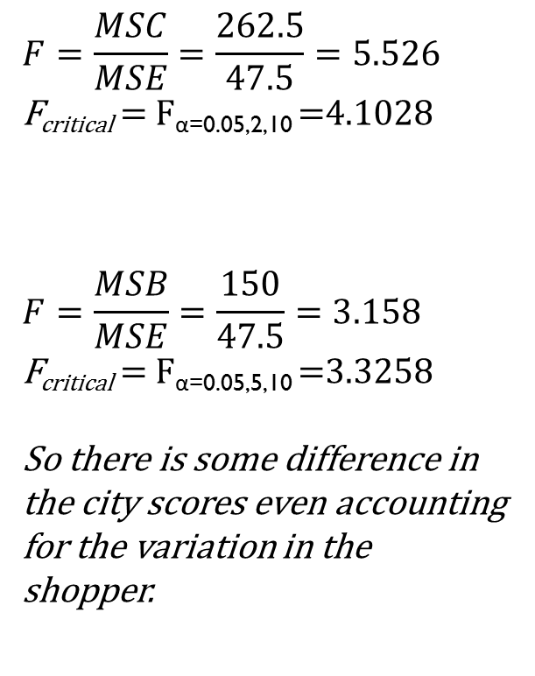
Example – Two way ANOVA – Without Rep
Step 6: Calculate F Critical Values
$$F=\frac{MSC}{MSE}=\frac{262.5}{47.5}=5.526$$
F_{critical} = F_{α=0.05,2,10} =4.1028
$$F=\frac{MSB}{MSE}=\frac{150}{47.5}=3.158$$
F_{critical} = F_{α=0.05,5,10} =3.3258
So there is some difference in the city scores even accounting for the variation in the shopper.
Is our F statistic larger than F_{critical} ?
Yes. Reject the H₀
Significant difference in Mean quality score by city.

Slide 48
Two way ANOVA – With Replication
In a Two way ANOVA with replication, we have multiple measurements per cell.
This allows for a new type of measurement which is called the interaction between two factors.
Basically in Two Way ANOVA we look for significant interactions between the cells or columns.

Slide 49
Example - Two way ANOVA – With Replication
Example: The agricultural researchers are interested in the effectiveness of three different types of plant foods AA, BB and CC.
They designed an experiment in which they test each plant food AA, BB and CC with two feeding per day for 75 days after planting. Eight plants are tested for each combination.
The variable of interest is the plant height in centimeters (cm).
This same type of plant seed is used for the entire experiment.
Determine:
Is there any difference in plant growth when comparing 1 feeding to 2 feedings per day ?
Do some plants grow better once per day and others grow better at twice per day ?

Slide 50
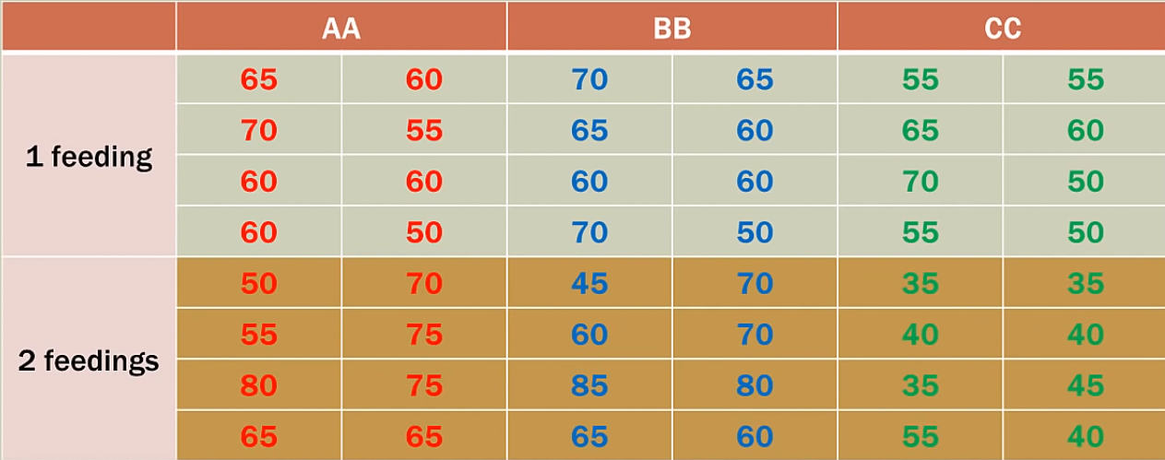
Example - Two way ANOVA – With Replication

Slide 51
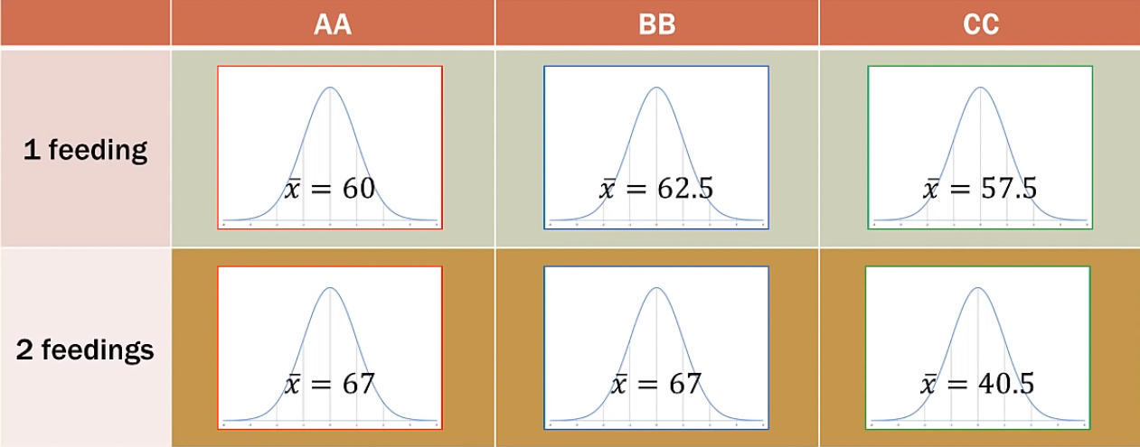
Example - Two way ANOVA – With Replication
Each cell has its own mean and variance, which makes Two Factor with replication special.

Slide 52
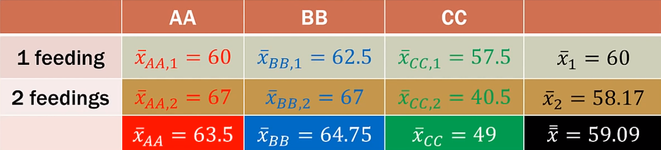
Example - Two way ANOVA – With Replication
Keep in mind that the points in the table are not the individual points but are the mean of their own distribution.

Slide 53
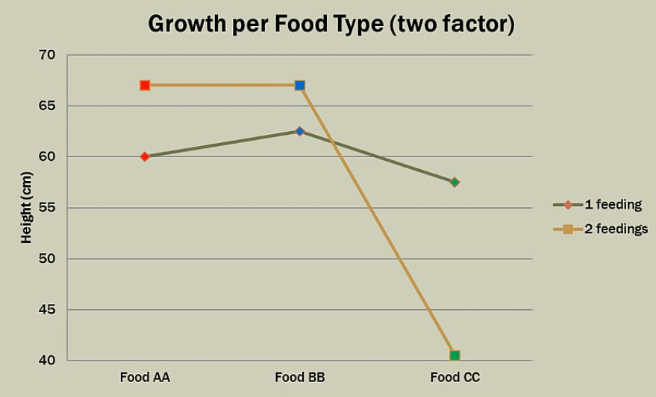
Example - Two way ANOVA – With Replication
Questions:
For AA, how many feedings produce more growth ?
For BB, how many feedings produce more growth ?
For CC, how many feedings produce more growth ?
Do two feedings produce more growth across ALL plant foods consistently ?

Slide 54
Example - Two way ANOVA – With Replication
Answers:
It appears that two feedings are better for AA and BB but not for CC.
This type of situation is called Interaction.
The interaction occurs when the effect of one factor changes for different levels of the other factor
In this case, the feeding frequency for food affects the plant growth.

Slide 55
Example - Two way ANOVA – With Replication
On a marginal means graph, usually:
The factor of interest or the factor with the most levels is on the horizontal axis.
The dependent variable is on the vertical axis (what to measure)
The second factor makes up the series lines by graphing the dependent variable for each level/category of the first factor
Look for the crossing or non-parallel lines on the graph i.e. interaction.
Always look for the interaction first.
If it is significant, then the relationship/significance of the factors cannot be analyzed. The factors are too intertwined.

Slide 56
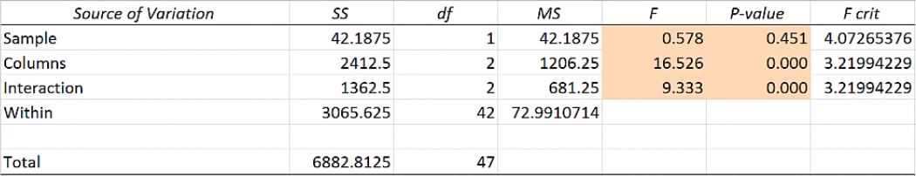
Example - Two way ANOVA – With Replication

Slide 57
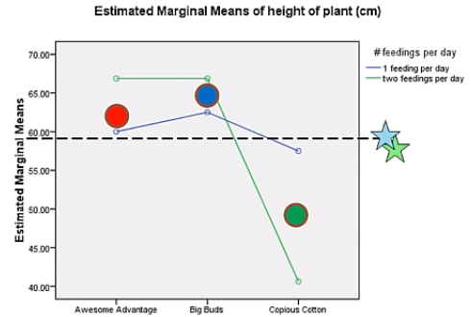
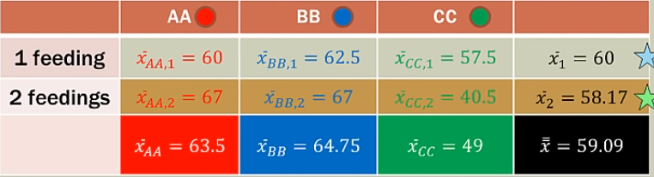
Example - Two way ANOVA – With Replication

Slide 58
Non-Parametric test
Mann-Whitney test:
It is a non-parametric test that is used to compare two population means that come from the same population, it is also used to test whether two population means are equal or not.
It does not assume any assumptions related to the distribution.
There are, however, some assumptions that are assumed:
1. The sample drawn from the population is random.
2. Independence within the samples and mutual independence is assumed.

Slide 59
Thank You

